Slide 1

Objectives
In this session, you will learn to:
  Identify various types of classes and the relationships between them
  Identify interfaces
Notes:
Initiate the session by explaining the session objectives to the students.

Slide 2
Identifying Types of Classes and Relationships between Classes
After you identify the classes from the problem statement or use cases, you can classify the identified classes into various types.
This enables you to make the software system reusable and manageable.
Notes:
Use the example of the Centralized Sales System for BlueSeas Group given in the student guide to explain Type classes and Implementation classes. Explain that a parameterized class uses formal parameters that are unbounded. This means that the data types of the parameters are not defined in the parameterized class.

Slide 3
Types of Classes
UML classifies classes into the following categories:
  Abstract class
  Parameterized class
  Factory class
  Self-linked class
Notes:
Use the example of the Centralized Sales System for BlueSeas Group given in the student guide to explain Type classes and Implementation classes. Explain that a parameterized class uses formal parameters that are unbounded. This means that the data types of the parameters are not defined in the parameterized class.

Slide 4

Types of Classes (Contd.)
Abstract class:
  An abstract class is a class that does not have any direct instances.
  The classes inherited from an abstract class can have direct instances.
  An abstract class is used to define the common features and common behavior of a set of subclasses.
  The UML notation for an abstract class is same as that of a simple class. However, the name of the class is italicized to indicate that the class is an abstract class.
Notes:
Use the example of the Centralized Sales System for BlueSeas Group given in the student guide to explain Type classes and Implementation classes. Explain that a parameterized class uses formal parameters that are unbounded. This means that the data types of the parameters are not defined in the parameterized class.

Slide 5
Types of Classes (Contd.)
Parameterized Class:
  A parameterized class provides a mechanism that enables you to use operations and classes to work with different data types.
  A parameterized class consists of type parameters that are unbounded.
  The data types of the parameters are not defined in the parameterized class.
  You cannot create the objects of a parameterized class.
  To use the functions defined in the parameterized class, you need to realize the parameterized class by using classes.
  The data types of the type parameters are defined in the classes that realize the parameterized class.
Notes:
Explain the advantages of using parameterized classes. Explain how parameterized classes work by using the example given in the student guide. Finally, explain the UML notation for a parameterized class.

Slide 6
Types of Classes (Contd.)
The following is the representation of a parameterized class.
ElementType: T
List
Add (T)
Notes:
Explain the advantages of using parameterized classes. Explain how parameterized classes work by using the example given in the student guide. Finally, explain the UML notation for a parameterized class.

Slide 7
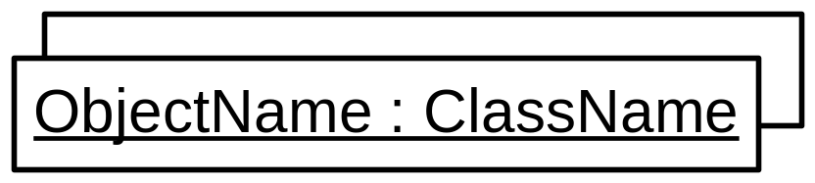
Types of Classes (Contd.)
Factory Class:
  A class whose multiple objects have same attribute values is known as a factory class.
  An example of a factory class is an EJB factory class that creates multiple instances of EJB in an instance pool of the J2EE middle tier server.
  You can represent the multiple objects of a factory class by single symbol of overlapping rectangles.
  The following is the representation of a factory class.
Notes:
Explain the concept of a factory class by using the example given on the slide. Also explain the symbol for a factory class.

Slide 8

Types of Classes (Contd.)
Self-Linked Class:
  A class whose objects fulfill more than one role is called a self-linked class.
  The following is the representation of a self-linked class.
Notes:
Explain the concept of a self-linked class and the notation for a self-linked class.

Slide 9
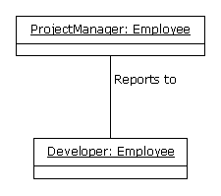
Recursive Aggregation and Qualified Association Relationships
Recursive Aggregation:
  Is an association relationship between two objects of the same class.
  The following figure shows the recursive aggregation relationship between the ProjectManager and Developer objects of the Employee class.
Notes:
Explain the concept of recursive aggregation in an object diagram by using the example given on the slide.

Slide 10
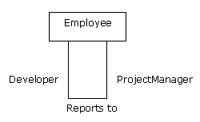
Recursive Aggregation and Qualified Association Relationships (Contd.)
The following figure shows recursive aggregation in a class diagram.
Notes:
Explain recursive aggregation in a class diagram by using the example given on the slide.

Slide 11
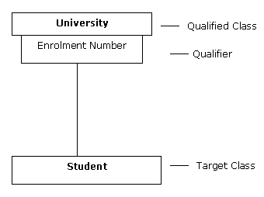
Recursive Aggregation and Qualified Association Relationships (Contd.)
Qualified Association:
  An association relationship that relates an object of a class to a particular object or a set of objects of another class.
  A qualifier is used to distinguish the objects of one class from another. A qualifier can be an attribute of the class.
  The following figure depicts a qualified association between the University class and the Student class.
Notes:
Explain the concept of qualified associationby using the example given on the slide.

Slide 12
Derived Elements
Can be derived from one or more elements of the same type.
Can be used to model an explicit detailed design.
Are represented in a class diagram by placing a slash (/) before the name of an element.
Are of two types:
  Derived attribute
  Derived association
Notes:
Explain the concept of derived elements and the two types of derived elements.

Slide 13
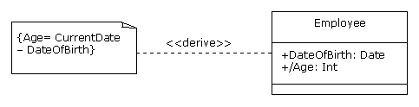
Derived Elements (Contd.)
Derived Attribute:
  The value of a derived attribute is calculated from the value of other attributes of the object.
  The formula for calculating the derived attribute is represented as a constraint in the class diagram.
  Representation of a derived attribute in UML notation is as follows:
Notes:
Explain the concept of derived attribute by using the example given on the slide.

Slide 14
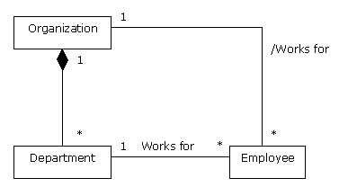
Derived Association
Derived Association:
  A derived association can be deduced from other associations in a class diagram.
  Representation of a derived association in UML notation:
Notes:
Explain the concept of derived association by using the example given on the slide.

Slide 15
Just a minute
Which of the following is an association relationship between two objects of the same class?
  Recursive aggregation
  Derived association
  Qualified association
  Derived attribute
Answer:
  Recursive aggregation
Notes:
Check the learning of the students by asking the question given on the slide.

Slide 16
Identifying Interfaces
An interface is a collection of operations that are used to represent the services provided by a class or component.
An interface provides the declaration of only the public methods and does not provide their implementation.
You cannot create objects of interfaces.
Notes:
Explain the concept of an interface. Explain the two types of notations for an interface.

Slide 17
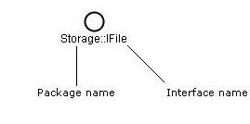
Creating Interfaces
In UML, an interface is represented as a circle. Each interface has a unique name that is prefixed with the name of the package in which it is contained.
The following figure shows an interface with the package name.

Slide 18
Creating Interfaces (Contd.)
UML provides two notations for representing interfaces:
  You can represent an interface as a circle.
  You can also represent an interface in the class notation, which contains the interface name preceded with the keyword, <<interface>>, and the methods declarations.
It is a good practice to prefix the name of an interface with, I, to distinguish it from other elements, such as classes.
Multiple classes or components can realize interfaces to provide the functions specified in the interfaces.
Notes:
Explain how interfaces are realized using classes. Also explain the two notations for realizing an interface, lollipop notation and dashed arrow notation.

Slide 19

Creating Interfaces (Contd.)
Multiple classes or components can realize interfaces to provide the functions specified in the interfaces.
UML provides two notations to realize an interface:
  Lollipop notation:

Slide 20
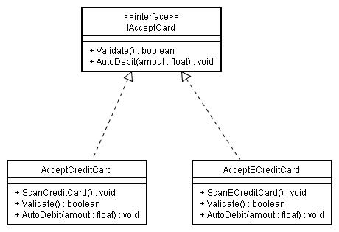
Creating Interfaces (Contd.)
  Dashed arrow notation:

Slide 21
Differentiating Abstract Classes from Interfaces
Abstract class and interfaces both provide the specification of methods but do not allow you to create instances directly.
The implementations of the methods specified in the abstract classes and interfaces are provided in the derived classes.
Dissimilarities between an abstract class and an interface are:
  Interfaces enable you to implement multiple inheritance because a class can implement more than one interfaces. However, abstract classes do not support multiple inheritance. A class cannot inherit more than one abstract class.
  An abstract class contains attributes and methods, which can be public, private, or protected. An interface consists of only methods.
Notes:
Explain the similarities and differences between abstract classes and interfaces.

Slide 22
Differentiating Abstract Classes from Interfaces (Contd.)
  An abstract class may provide the definition of some of its methods but interfaces do not provide any definitions.
  An abstract class is used in the same package where as an interface can be realized across multiple packages.
Notes:
There are various terms, such as classifiers and enumerations, which are used in modeling languages and in programming languages. Students may come up with these terms and may want to know more about them in the context of UML. You can refer to the following content for information about classifiers and enumerations.
Classifier
In UML, any element that can have instances, such as classes and interfaces, is known as a classifier. The exceptions to this rule are association and messages that can have instances but do not classify as classifiers. Note that classifiers contain the structural and behavioral features of software systems. Structural features represent the attributes contained in a classifier, and behavioral attributes represent the operation defined in the classifier. Every instance of the classifier shares the same features. The various other types of classifiers in UML are actors, components, data type, node, signal, and use cases.
Enumeration
An enumeration is a user-defined datatype. It allows you to define and name the datatypes by using its own attributes called literal names. You need to specify the value of the first literal name and the remaining literal names are enumerated starting from the value specified, by default. For example, the datatype, Boolean, contains two attributes, false and true. If you specify the integer value, 0, to false, the literal name, true, automatically takes the value, 1. You can also explicitly specify the value for each literal name.
An enumeration is represented as a rectangle with three compartments:
The first compartment contains the keyword, <<enumeration>>, before the enumeration name.
The second compartment consists of a list of enumerated literal names.
The third name consists of a set of defined operations.
The following figure shows how to represent an enumeration.
<<<<<<<<<INSERT FIGURE>>>>>>>>>>>

Slide 23
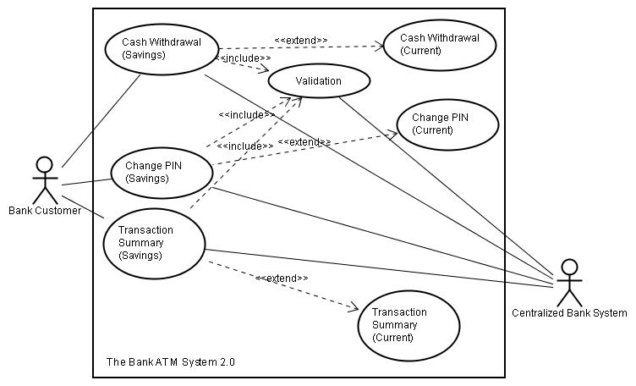
Demo: Modeling the Static View of the Bank ATM System
Problem Statement:
  Janes Technology has been assigned the task of creating a prototype for the InfoSuper bank ATM system. The project manager of Janes Technology has created the following use case diagram for the prototype after gathering requirements from InfoSuper bank:
Notes:
Explain the problem statement given on the slide to the students.

Slide 24
Demo: Modeling the Static View of the Bank ATM System (Contd.)
  The use case diagram depicts that the customers of the InfoSuper bank can have savings and current accounts. The ATM system allows the customers to withdraw cash after the ATM card and PIN of the customers is validated. The ATM system also enables the customers to change PIN and obtain a transaction summary.
  To model the static view of the prototype, the project manager needs to create the following diagrams:
    Class diagram
    Object diagram

Slide 25
Demo: Modeling the Static View of the Bank ATM System (Contd.)
Solution:
  To model the static view of prototype of the InfoSuper bank ATM system, you need to perform the following tasks:
    Identify the classes for the prototype.
    Identify the attributes and their visibility.
    Identify the operations and their visibility.
    Identify the relationships among classes.
    Identify interfaces and their realization relationships.
    Create a Class diagram.
    Create an Object diagram.
Notes:
Before starting the demo, you need to copy the required data file from the <<<<<<<PATH>>>>>>>>>> folder. The required data file’s name is Bank_ATM.vsd.
Demonstrate the solution to the problem statement by following the steps given in the student guide. If you want to show students the final diagram that will be created after performing the demo, you can open the Bank_ATM.vsd file from the <<<<<<<PATH>>>>>>>>> folder.
The demo does not repeat similar steps. However, you would be able to complete the diagram with the steps written in the demo.
The demo uses Visio to model the static view of the bank ATM system. The demo describes how to model a class, an object, and an interface for the cash withdrawal use case. It outlines the procedure to create the class diagram, such as identification of classes, their attributes, and operations. Similarly, the interface diagram identifies the realization relationship among interfaces.

Slide 26
Summary
In this session, you learned that:
  An abstract class is a class that does not have any direct instances.
  An abstract class is used to define the common features and common behavior of a set of subclasses.
  A parameterized class, also called template class, provides a mechanism that enables you to use operations and classes to work with different data types.
  The objects of a parameterized class cannot be created.
  A class that has multiple objects having the same attribute values is known as a factory class.
  A class that has objects, which fulfill more than one role, is called a self-linked class.
Notes:
Summarize the session by using the summary points given in the slide.

Slide 27
Summary (Contd.)
  In addition to generalization, dependency, and association relationships, you can also represent the following relationships among classes and objects:
    Recursive aggregation
    Qualified association
  A derived element can be derived from one or more other elements of the same type.
  An interface is defined as a collection of operations that specifies a particular service of a class or a component.
Notes:
Summarize the session by using the summary points given in the slide.

